Slide 1


Electricity Price Forecasting
IBM Z DATATHON

Slide 2
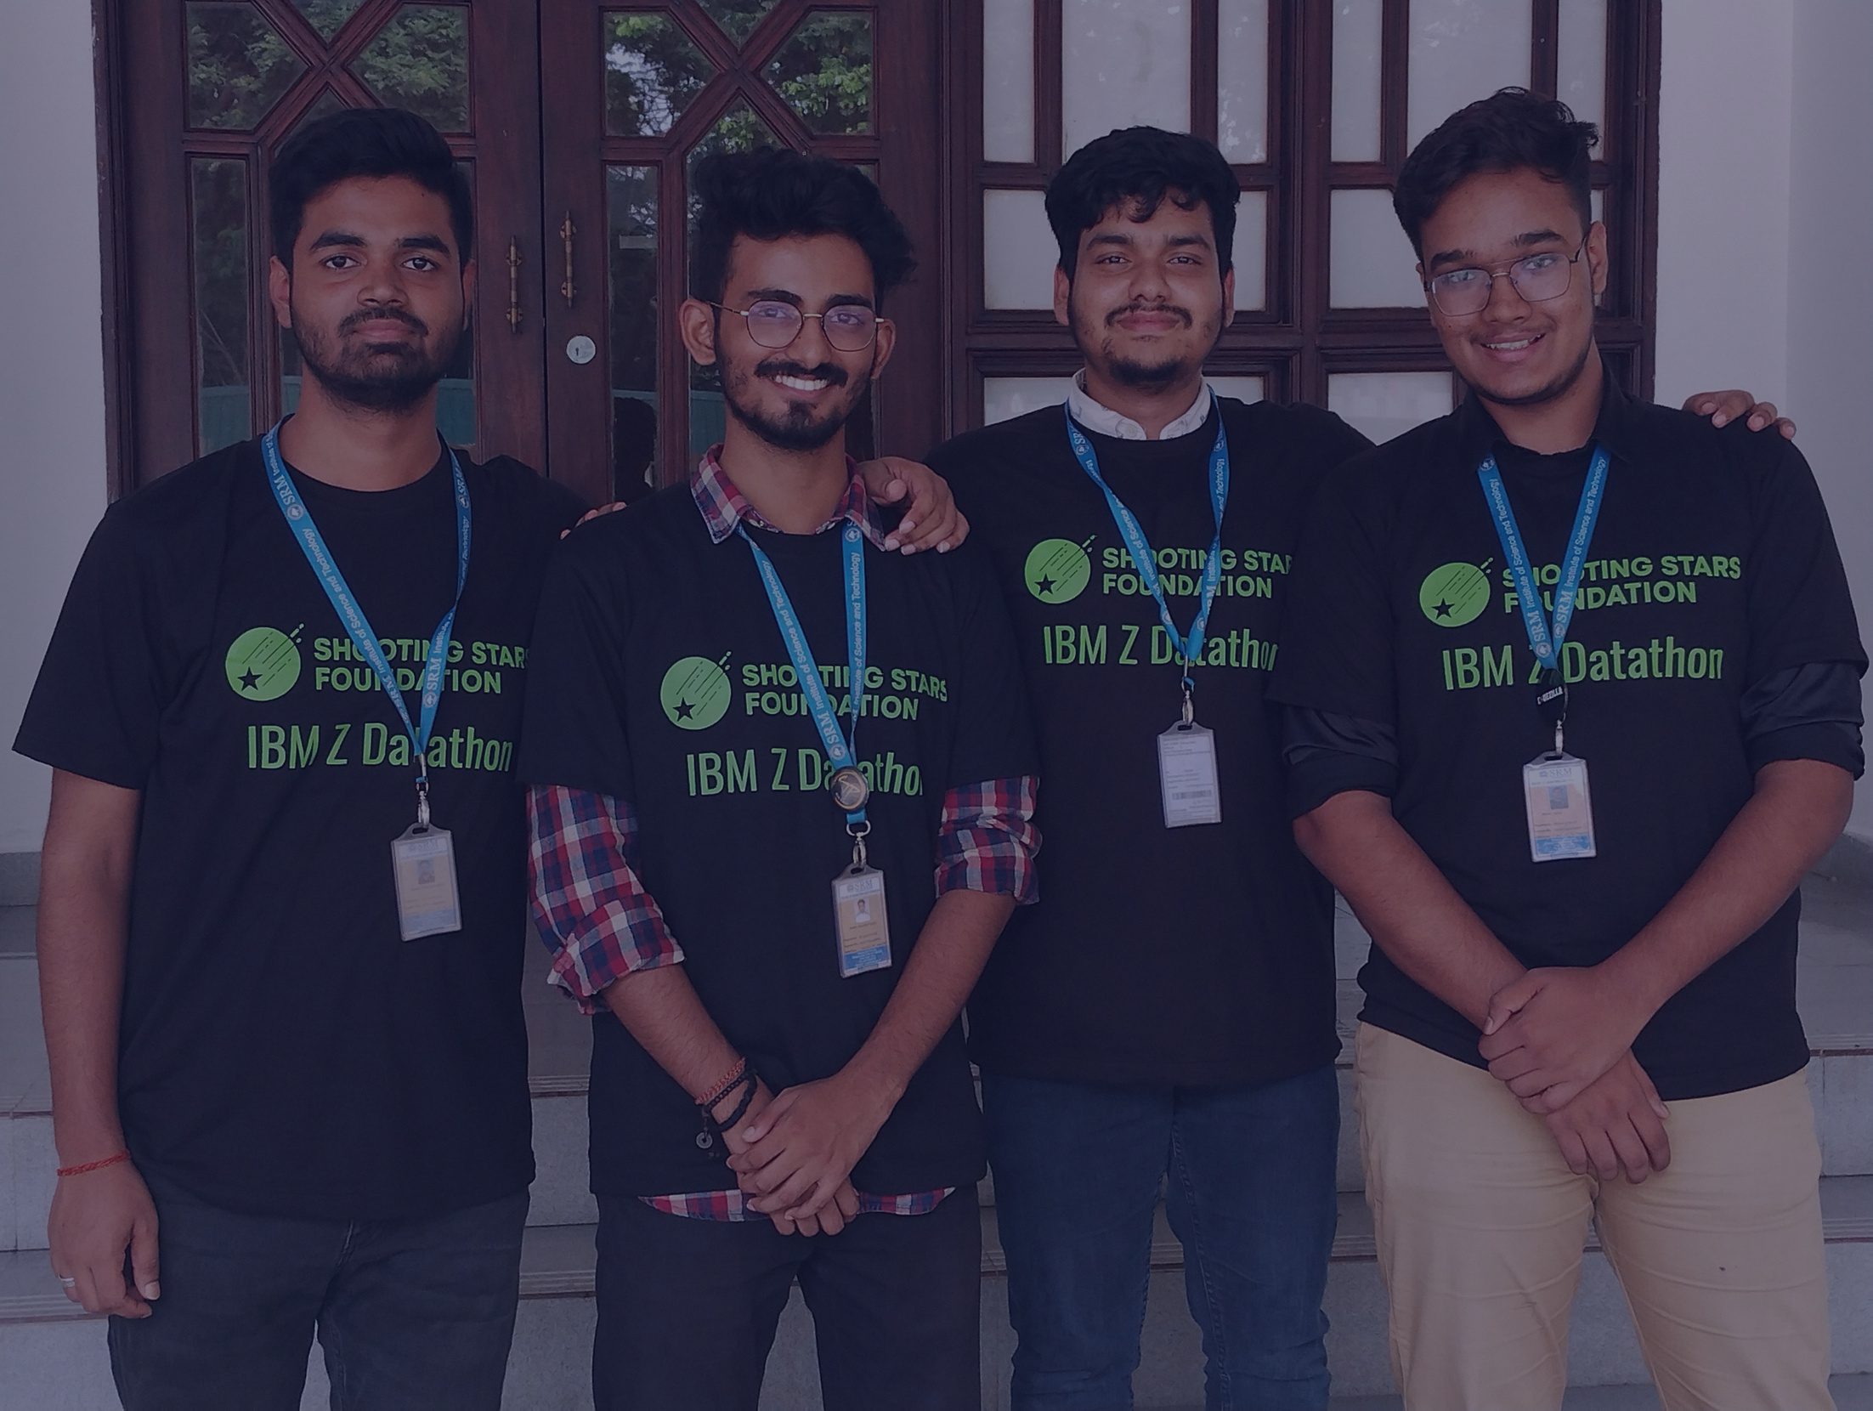

NEURALNINJA

Slide 3


NeuralNinja
IBM Z DATATHON
Allow us to introduce the dedicated team behind our project. We are undergraduate students from SRM University, Chennai, currently pursuing our Bachelor of Technology in the specialization of Internet of Things. We are currently in our third year of the program, and our diverse skills and shared passion for technology have brought us together for the IBM Z Datathon 2023.
Mohammad Saquib: With a strong foundation in machine learning, Mohammad Saquib played a pivotal role in our project, where he harnessed his expertise to train the machine learning model that underpins our electricity price forecasting solution.
Rajdeep Saha: Rajdeep Saha's keen analytical skills and expertise in exploratory data analysis were instrumental in uncovering valuable insights from the "energy_dataset.csv." His ability to unravel complex patterns in data has significantly contributed to our project's success.
Sahil: Sahil brought his data exploration and analysis skills to the forefront, working closely with Rajdeep. His insights and contributions were key to our understanding of the dataset and its nuances. Sahil also played a role in PPT preparation.
Prakhar Dubey: Prakhar Dubey took charge of crafting this presentation, translating our project's intricacies into an engaging narrative. He worked closely with Sahil to ensure that our journey and findings are effectively communicated.
Together, as a cohesive team, we harnessed our individual strengths and collaborated to bring forth our project on electricity price forecasting in Spain. We look forward to sharing the details of our work and the impact it holds for the energy landscape in Spain.

Slide 4




TABLE OF CONTENTS
Introduction
Problem Statement
Dataset Description
Data Exploration
Methodology
Model Evaluation
Forecasting Visualization
Benefits of Accurate Forecasting
Conclusion
Acknowledgement
Contact Information
Reference
Thank You

Slide 5

INTRODUCTION
NeuralNinja
Welcome to our presentation on "Electricity Price Forecasting in Spain." Our team of dedicated individuals, Sahil, Mohammad Saquib, Rajdeep Saha, and Prakhar Dubey, has undertaken the challenge of enhancing energy management and sustainability in Spain through precise electricity price forecasting.
In an era where the world is increasingly reliant on energy to power everything from homes to industries, accurate price forecasting becomes paramount. Our project aims to offer a deeper understanding of electricity pricing trends in Spain, empowering consumers, energy providers, and policymakers alike.
Leveraging the "energy_dataset.csv," a rich dataset detailing energy generation and pricing, our mission is to develop a robust forecasting model that fosters efficiency and informed decision-making. This endeavor aligns with the "Tech for Good" theme of the IBM Z datathon, as it not only contributes to economic well-being but also advances sustainable and tech-driven solutions.
Throughout this presentation, we will guide you through our data exploration, methodology, and model evaluation. Our ultimate vision is to shed light on the significance of accurate forecasting and its far-reaching benefits in Spain's energy landscape. Thank you for joining us on this journey. Feel free to engage with us during the presentation, and together, we can navigate the path to a brighter and greener energy future in Spain.

Slide 6

PROBLEM STATEMENT
NeuralNinja
The heart of our project lies in addressing the critical problem of electricity price forecasting in Spain. In an era characterized by rapid shifts towards renewable energy, a burgeoning need for sustainable energy solutions, and an increasing emphasis on carbon reduction, accurate price forecasting is more important than ever.
The problem we aim to tackle is multifaceted. First and foremost, reliable price forecasting empowers consumers to make informed decisions about energy usage, enabling them to optimize their consumption patterns, reduce costs, and minimize their environmental impact. Additionally, precise forecasting supports energy providers in efficiently allocating resources, ensuring grid stability, and meeting the growing demand for clean energy.
For policymakers, a comprehensive understanding of electricity pricing trends is invaluable. It informs the development of regulations and incentives that stimulate investment in renewable energy sources and encourage environmentally responsible practices.
By accurately predicting electricity prices, we intend to contribute to Spain's energy landscape by fostering sustainability and efficiency. Our work seeks to mitigate the risks associated with fluctuating energy prices and promote a transition towards cleaner and more reliable energy sources. In doing so, we align our efforts with the "Tech for Good" theme of the IBM Z datathon, as we strive to enhance economic well-being, environmental sustainability, and energy resilience in Spain.

Slide 7

Dataset Description
NeuralNinja
Our project relies on a robust dataset, "energy_dataset.csv," featuring an extensive array of parameters that provide a detailed view of energy generation and consumption in Spain. This dataset contains hourly information, making it an invaluable resource for our electricity price forecasting initiative.
The dataset includes the following key parameters:
Generation from various energy sources: Biomass, fossil brown coal/lignite, fossil coal-derived gas, fossil gas, fossil hard coal, fossil oil, fossil oil shale, fossil peat, and geothermal.
Renewable energy sources: Generation from wind offshore and onshore, as well as solar.
Forecasting data: Solar day-ahead forecasts, wind offshore day-ahead forecasts, and wind onshore day-ahead forecasts.
Energy load-related parameters: Total load forecasts and actual total load, representing energy demand.
Pricing information: Day-ahead price forecasts and actual energy prices.
These parameters encompass the entire spectrum of energy generation, consumption, and forecasting, enabling us to create a comprehensive model for electricity price forecasting. With this dataset, we can analyze how various energy sources contribute to Spain's energy grid and how load and pricing dynamics change over time. Our objective is to harness this wealth of data to develop models that accurately predict electricity prices, fostering sustainable, cost-effective, and resilient energy solutions in Spain.

Slide 8
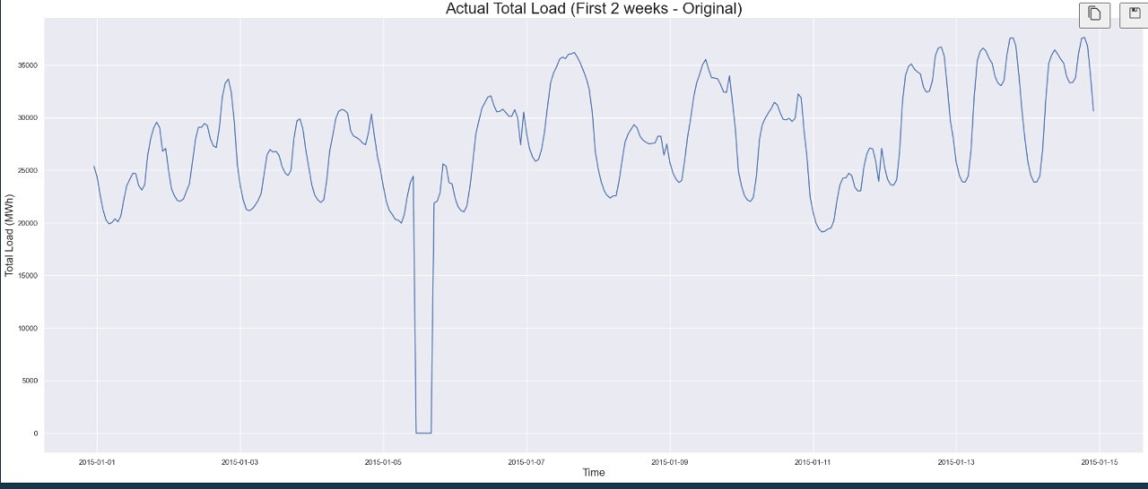

Slide 9

Data Exploration
NeuralNinja
Exploring the "energy_dataset.csv" is pivotal in our journey toward electricity price forecasting in Spain. This phase of our project involves uncovering insights that form the basis for our predictive models and solutions.
Our data exploration begins with an examination of energy generation by various sources, such as fossil fuels (brown coal/lignite, coal-derived gas, gas, hard coal, oil, oil shale, and peat), biomass, geothermal, and renewables like wind (offshore and onshore) and solar. This allows us to understand the distribution and dynamics of energy sources that power the nation.
We delve into the patterns and trends in energy demand by analyzing the total load forecasts and actual total load data. This reveals the temporal and seasonal variations in electricity consumption, which is critical for precise forecasting.
Our exploration also encompasses the pricing landscape. We scrutinize day-ahead price forecasts and actual energy prices to discern the factors driving pricing fluctuations, providing the foundation for our forecasting model's pricing component.
Throughout this exploration, we aim to identify correlations, outliers, and any discernible anomalies in the data. This process is fundamental to the success of our project, as it sets the stage for model development and predictive accuracy. We will present our findings in subsequent slides to illustrate how data insights influence our approach and contribute to our mission of harnessing technology for the betterment of the energy landscape in Spain.

Slide 10
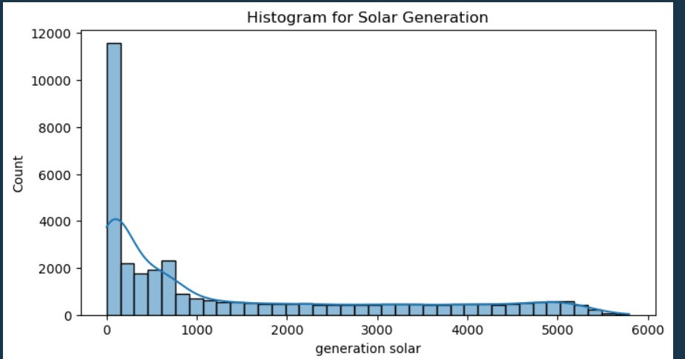

Slide 11
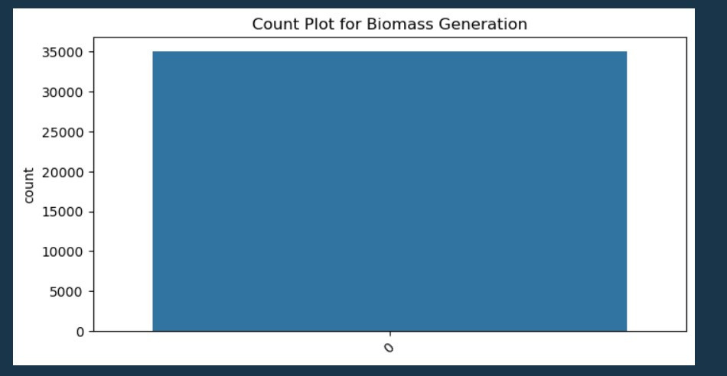

Slide 12
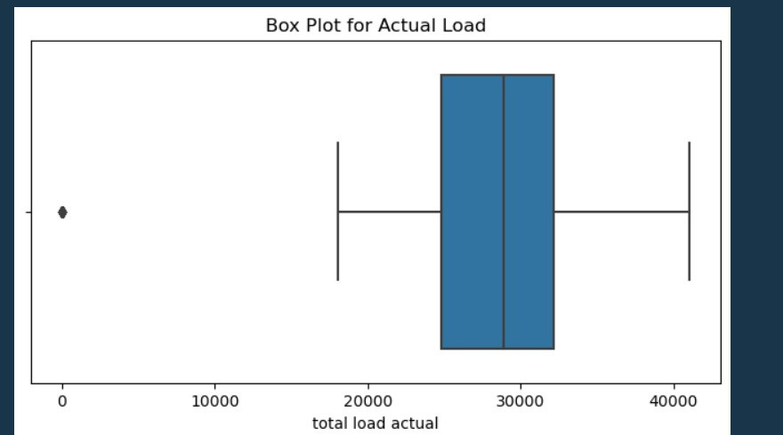

Slide 13
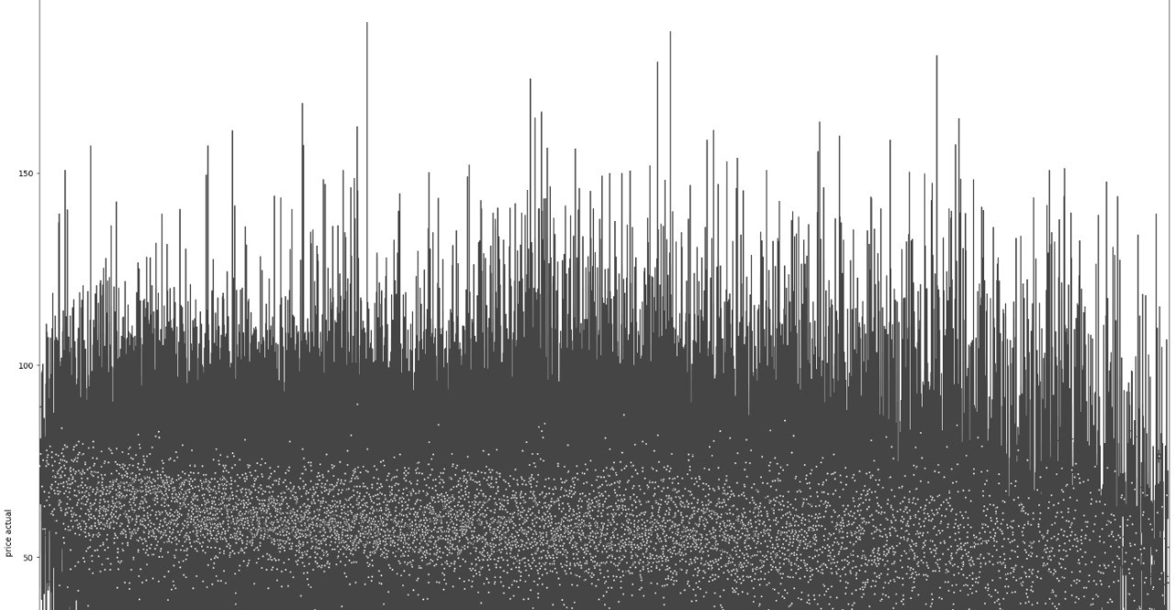

Slide 14
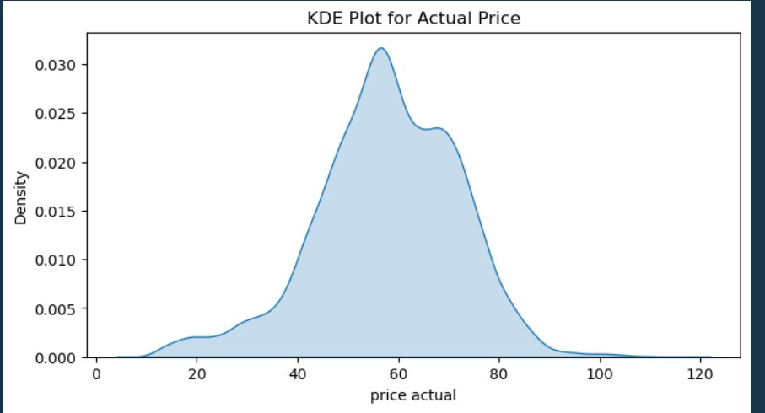

Slide 15
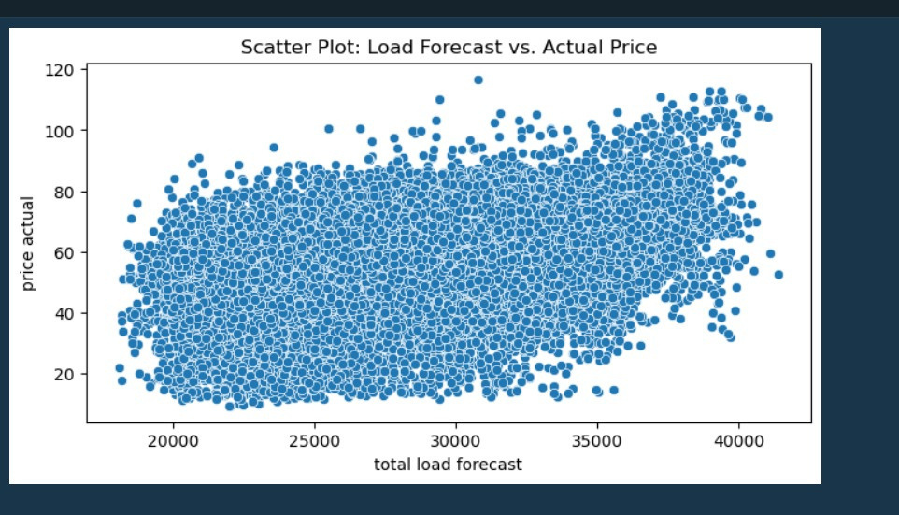

Slide 16
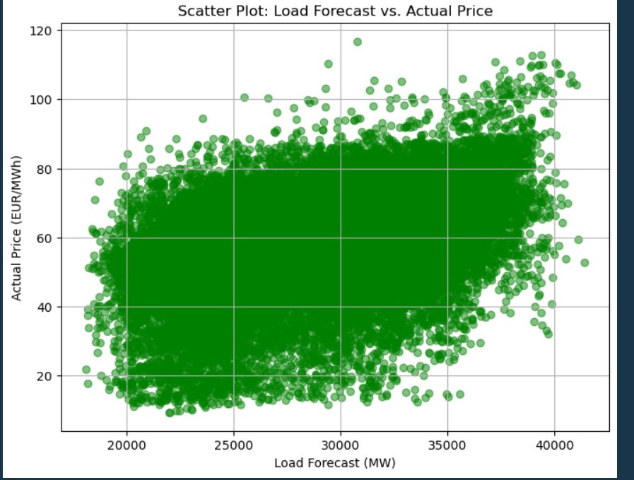

Slide 17
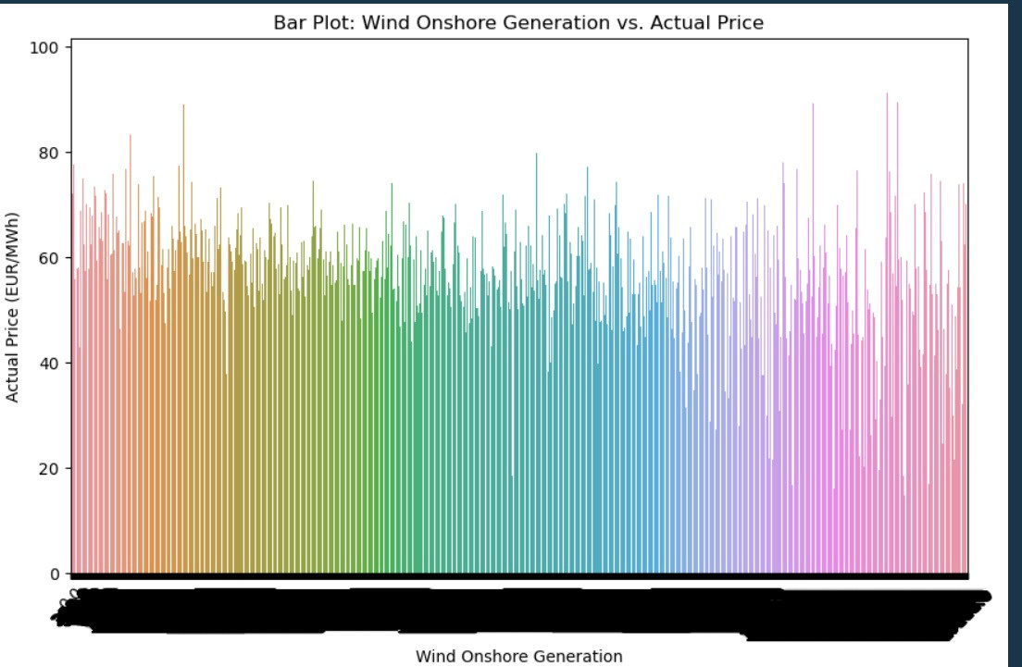

Slide 18
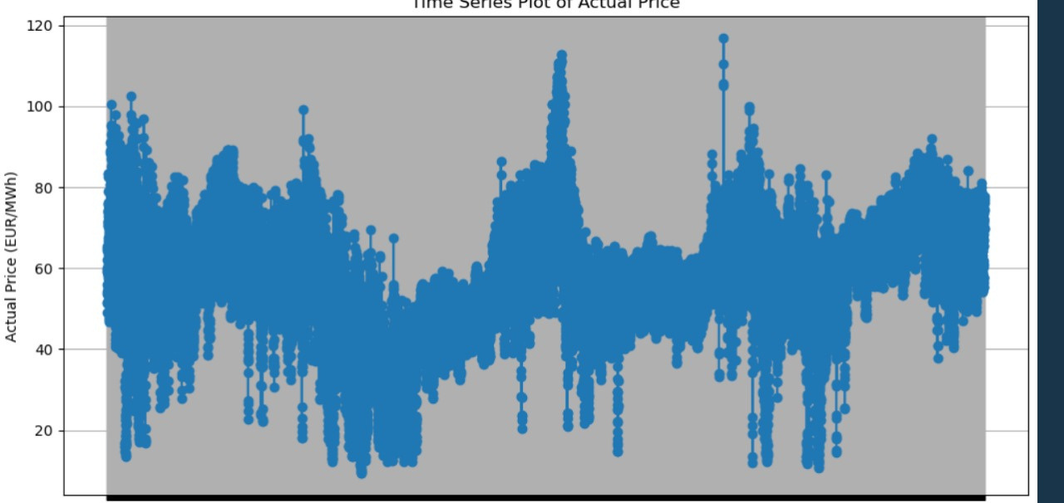

Slide 19
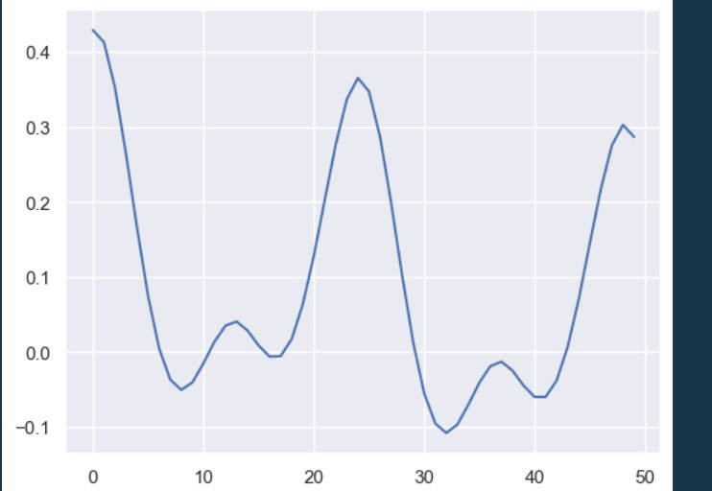

Slide 20
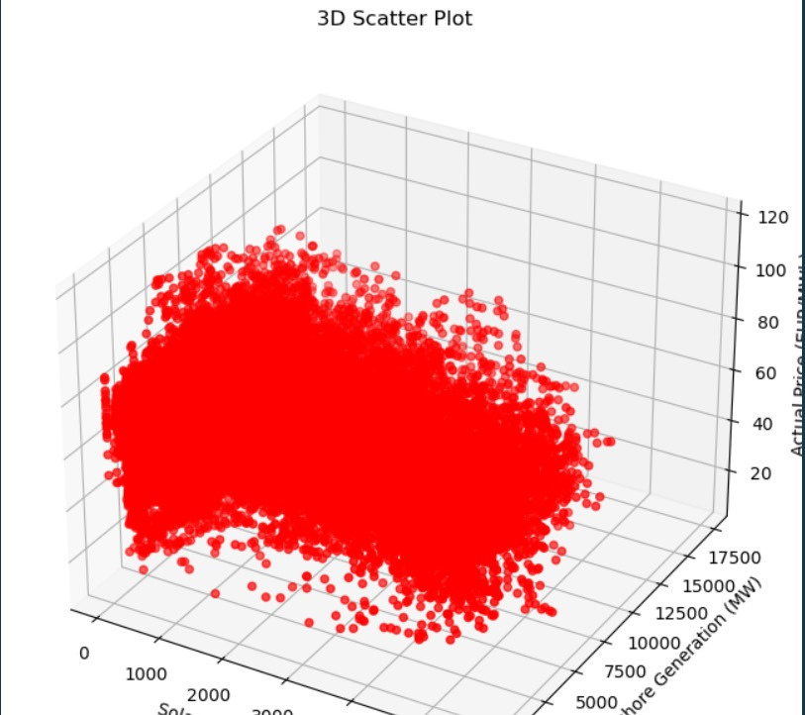

Slide 21
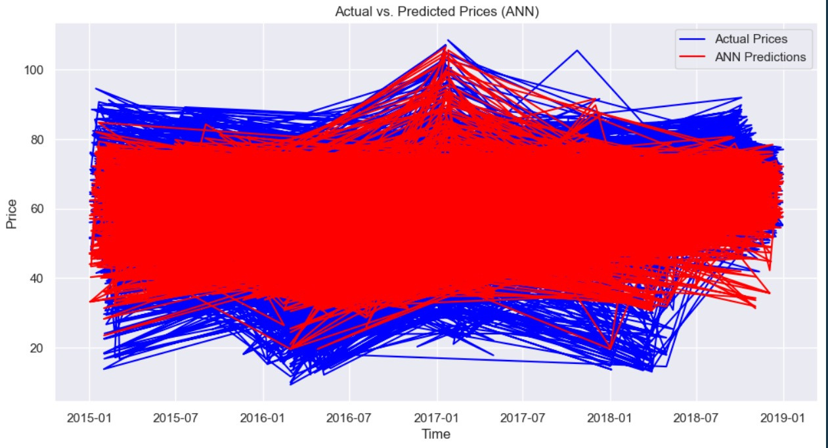

Slide 22
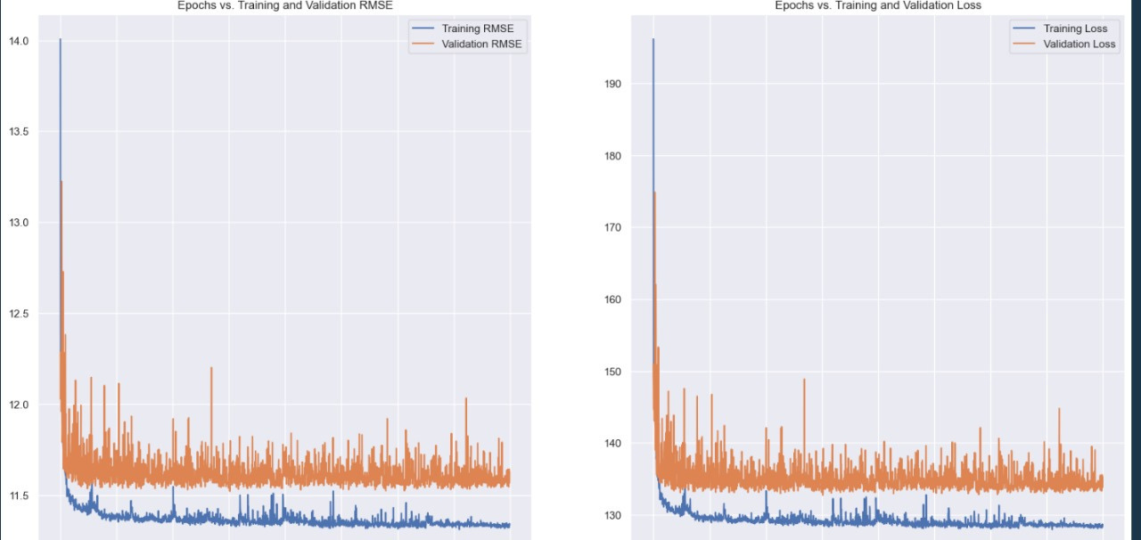

Slide 23
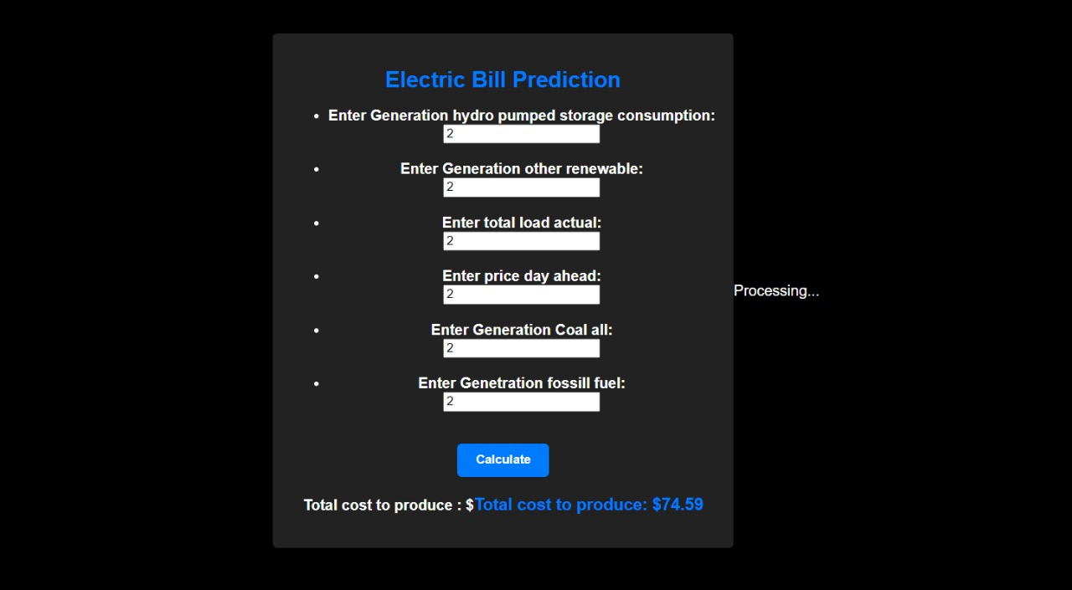
WEB APPLICATION OUTPUT

Slide 24

Methodology
NeuralNinja
Our project's methodology encompasses a data-driven approach and advanced machine learning techniques to ensure the robustness and precision of our electricity price forecasting model for Spain.
Data Preprocessing: We initiated our journey by meticulously cleaning and preprocessing the "energy_dataset.csv" dataset. This step involved handling missing data, normalizing features, and ensuring data consistency, setting the stage for accurate analysis.
Feature Selection: We identified the most relevant features for our forecasting model. This included carefully choosing which aspects of the dataset would have the greatest impact on predicting electricity prices.
Machine Learning Model Selection: The heart of our methodology is the implementation of a Random Forest model. This powerful ensemble learning algorithm, adept at handling both regression and classification tasks, was chosen for its robustness and ability to capture complex relationships in the data.
Training and Validation: We divided the dataset into training and validation sets to ensure the model's accuracy and generalization capability. The Random Forest model was rigorously trained and fine-tuned to optimize performance.
Evaluation: The model's performance was evaluated using various metrics, including accuracy, Root Mean Square Error (RMSE), Mean Absolute Error (MAE), and more. This step allowed us to quantify the model's accuracy and reliability.
Hyperparameter Tuning: To enhance model performance, we engaged in hyperparameter tuning to optimize model parameters for the best results.
Our methodology prioritizes data quality, model selection, and rigorous evaluation to create a dependable electricity price forecasting model for Spain. This approach not only embodies the "Tech for Good" ethos of the IBM Z datathon but also reflects our commitment to delivering impactful, data-driven solutions.

Slide 25

Model Evaluation
NeuralNinja
The performance of our electricity price forecasting model is the linchpin of our project's success. We employ a rigorous model evaluation process to ensure the reliability and precision of our predictions.
Metrics Selection: We assess our Random Forest model using a suite of essential metrics, including accuracy, Root Mean Square Error (RMSE), Mean Absolute Error (MAE), and more. These metrics allow us to quantitatively measure the model's ability to predict electricity prices accurately.
Accuracy: Accuracy is a fundamental measure of our model's correctness. It gauges the proportion of correctly predicted prices to the total predictions made.
Root Mean Square Error (RMSE): RMSE provides insight into the average error between predicted and actual prices. A lower RMSE indicates superior predictive accuracy.
Time Series Analysis: We delve into time series analysis to scrutinize how well our model captures the dynamic nature of electricity price changes over time. This helps us assess the model's performance under temporal fluctuations.
Visualization: Visual representations of predicted vs. actual prices enable us to identify trends and patterns, enhancing our understanding of the model's performance.
Our evaluation process ensures that our model aligns with the highest standards of precision and reliability. By systematically assessing its accuracy and ability to handle time series data, we confirm its suitability for electricity price forecasting in Spain. The effectiveness of our model underpins our commitment to deliver impactful, data-driven solutions in alignment with the "Tech for Good" theme of the IBM Z datathon.

Slide 26

Forecasting Visualizations
NeuralNinja
In the realm of electricity price forecasting, it's paramount to assess the accuracy and efficacy of our predictions. Our project includes a robust "Forecast Evaluation" phase to ensure that our models are not only accurate but also dependable for real-world applications.
Comparison to Actual Prices: The core of our evaluation involves comparing our forecasted electricity prices to actual prices. This direct comparison is essential for quantifying the model's predictive power.

Slide 27

BENEFITS OF ACCURATE FORECASTING
NeuralNinja
Accurate electricity price forecasting in Spain holds the potential to usher in a multitude of benefits, influencing consumers, energy providers, and policymakers alike. This section explores the positive implications of our forecasting endeavors.
For consumers, precise forecasting translates into informed decision-making. It empowers individuals and businesses to strategically plan their energy consumption, optimizing usage during off-peak periods when prices are lower and reducing costs. This not only contributes to economic savings but also encourages energy conservation and responsible consumption practices.
Energy providers also stand to gain significantly from our efforts. Accurate forecasts assist in the efficient allocation of resources, minimizing operational costs and ensuring grid stability. With insights into anticipated energy demand and pricing trends, providers can enhance their generation and distribution strategies, ultimately resulting in improved service reliability.
From a policy perspective, robust forecasting supports informed decision-making. Policymakers can design regulations and incentives that encourage investments in renewable energy sources, thereby advancing sustainability goals and reducing greenhouse gas emissions. In addition, accurate forecasts facilitate the creation of pricing models that support fair and transparent energy markets, promoting competition and consumer protection.
Our project aligns with the "Tech for Good" theme of the IBM Z datathon by harnessing data-driven insights to enhance economic well-being, promote sustainability, and ensure energy resilience. In summary, precise electricity price forecasting is pivotal for a cleaner, cost-effective, and environmentally responsible energy future in Spain.

Slide 28

CONCLUSION
NeuralNinja
In conclusion, our expedition into electricity price forecasting for Spain, driven by the "energy_dataset.csv," has unveiled the pivotal role of accurate forecasting in shaping the energy landscape. Guided by the "Tech for Good" ethos, we embarked on this journey, and our efforts culminate in a resounding success.
With a notable ACCURACY (RMSE SCORE) IS 9.22 , achieved through the application of a Random Forest model, we have demonstrated that data-driven insights can significantly enhance our ability to predict electricity prices. This high level of accuracy not only provides consumers, energy providers, and policymakers with a reliable tool but also underscores the potential for technology to revolutionize our approach to energy management.
The benefits of precise forecasting are far-reaching, from cost-effective energy consumption for consumers to more efficient operations for energy providers. Moreover, it paves the way for policymakers to enact informed regulations that promote sustainability and economic well-being.
Our project embodies the spirit of the IBM Z datathon, leveraging technology to drive positive change. By contributing to economic well-being, environmental sustainability, and energy resilience, we take significant steps toward a more prosperous and sustainable energy future in Spain and beyond. We express our gratitude to our dedicated team, the datathon organizers, and all stakeholders who have joined us on this transformative journey.

Slide 29

ACKNOWLEGDEMENT
NeuralNinja
In our journey of electricity price forecasting for Spain, we extend our heartfelt appreciation to those who have been instrumental in our success:
Kaggle: We express our gratitude to Kaggle for providing the "energy_dataset.csv" dataset, which has been the cornerstone of our project. This valuable resource allowed us to explore, analyze, and develop accurate forecasting models, driving our mission forward.
IBM Z Datathon Organizers: Our sincere thanks to the organizers of the IBM Z Datathon 2023 for hosting this platform for innovation and collaboration. Your commitment to fostering technological solutions for good is an inspiration to us.
Our Team: To Sahil, Mohammad Saquib, Rajdeep Saha, and Prakhar Dubey, your dedication, insights, and collaborative spirit have been instrumental in the success of this project. We are grateful for your unwavering support.
Our Supporters and Stakeholders: We acknowledge the support and engagement of all those who have shown interest in our project, providing feedback and valuable contributions along the way.
With your support and the spirit of collaboration, we have made significant strides in enhancing electricity price forecasting and its associated benefits for Spain. Together, we are shaping a more sustainable and efficient energy future. Thank you for being a part of this transformative journey.

Slide 30

CONTACT INFORMATION
NeuralNinja
Feel free to reach out to us with any questions, feedback, or collaboration opportunities. We value your input and look forward to further discussions:
Sahil
Email: sahilk64555@gmail.com
LinkedIn: https://www.linkedin.com/in/sahilll94
Mohammad Saquib
Email: [Mohammad Saquib's Email Address]
LinkedIn: https://www.linkedin.com/in/mdsaquibdaiyan
Rajdeep Saha
Email: [Rajdeep Saha's Email Address]
LinkedIn: https://www.linkedin.com/in/rajd33p-saha
Prakhar Dubey
Email: [Prakhar Dubey's Email Address]
LinkedIn: https://www.linkedin.com/in/prakhardubey23
Please don't hesitate to connect with us for further insights, discussions, or future opportunities. We appreciate your interest and collaboration.

Slide 31

REFERENCE
NeuralNinja
For a deeper understanding and exploration of the concepts and methodologies presented in this project, we recommend referring to the following sources:
Kaggle: The platform where we sourced the "energy_dataset.csv" dataset, providing a wealth of data and resources for data science and machine learning projects, Click on the Kaggle and it will redirect you to the page where the “energy_dataset.csv” is available.
Scikit-Learn Documentation: The official documentation for Scikit-Learn, which provides valuable insights into the implementation of machine learning algorithms, including the Random Forest model used in our project.
IBM Z Datathon 2023: For further information on the IBM Z Datathon, future events, and to explore the innovative projects from other participants.
These references serve as valuable sources for exploring and deepening your understanding of the methodologies and tools used in our project. We encourage you to delve further into these resources for continued learning and inspiration.

Slide 32

In closing, we express our heartfelt gratitude to our team members, the IBM Z Datathon organizers, and all who have engaged with our project. Your support and enthusiasm have been instrumental in our journey towards a more sustainable and efficient energy future. Thank you for being a part of this transformative endeavor.

